Slide 1
ANGULAR FUNDAMENTALSParte 1
Alejandro Coves Vives

Slide 2
01
02
Contenido
03
04
Starting
Hola Angular
Todo lo necesario para empezar
Entendiendo angular cli, creación del proyecto inicial de 0 y sus características
Entendiendo conceptos
Creación de modules y componentes
Creación y uso de componentes y de modules
Data binding, property binding, event binding y modelos

Slide 3
01
STARTING
Todo lo necesario para empezar tu proyecto de angular

Slide 4



Necesario para empezar
Nodejs
Angular cli
Typescript
Angular utiliza node en su entorno habitual, ya sea para builds, instalación de paquetes, etc
Paquetería para gestionar creación de un montón de elementos relacionados con angular, hace la vida más fácil para el desarrollador
Añade tipado al código de javascript, además de un montón más de utilidades para hacer el código más mantenible, limpio e intuitivo.

Slide 5
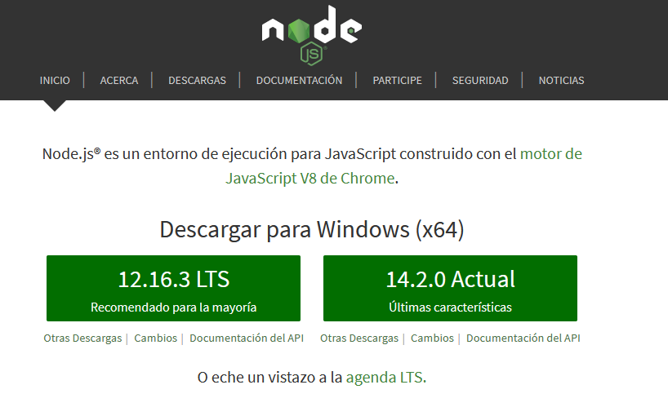
NODE JS
Lo utiliza angular por debajo:
https://nodejs.org/es/
Tanto para las builds, instalación de packetes, scripts propios, etc.

Slide 6
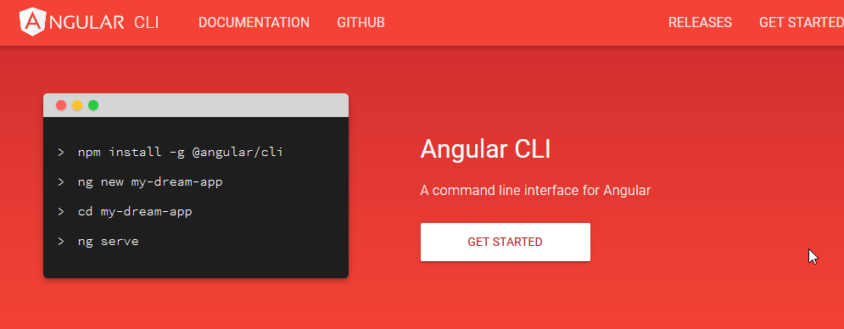
ANGULAR CLI
Herramienta que facilita la creación y manejo de proyecto con angular.
https://cli.angular.io/
Creación sencilla de elementos
Sigue las buenas prácticas de programación al crear los componentes

Slide 7
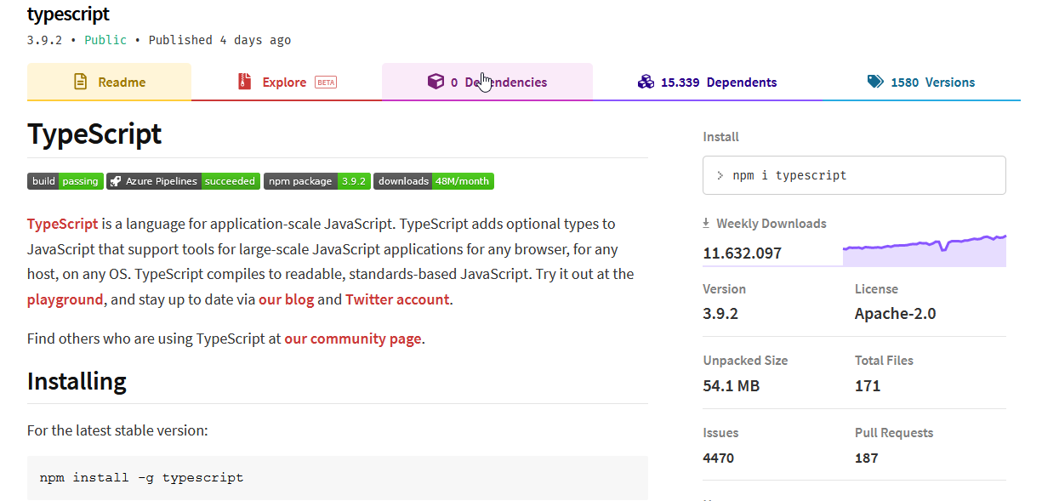
TYPESCRIPT
Nos da muchas facilidades a la hora de programar:
Código tipado con posibilidad de usar generics
EL código se compila en JavaScript que puede ser usado en cualquier entorno
Se instala como paquete npm

Slide 8
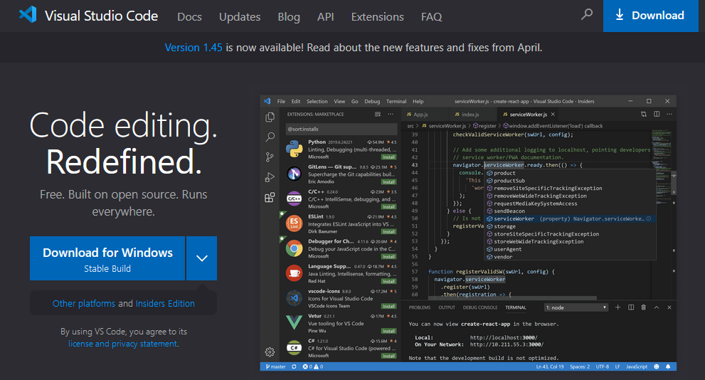
IDE: VISUAL STUDIO CODE
Podéis usar el que queráis, yo uso este por:
Gratis
Muy customizable, multitud de plugins para facilitar la vida del programador
Comunidad muy activa
https://code.visualstudio.com/

Slide 9
02
HOLA ANGULAR
Entendiendo angular cli, creación del proyecto inicial de 0 y sus características

Slide 10
—ANGULAR CLI
Para crear un nuevo proyecto en angular es tan sencillo como:
ng new curso-angular

Slide 11
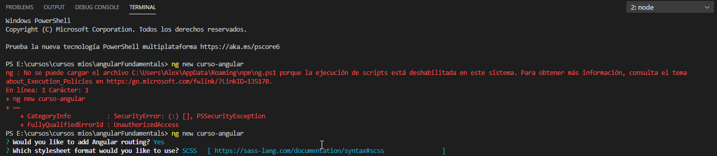
PEQUEÑOS PROBLEMAS
Si os da un error de ejecución de scripts:
Buscador de Windows > Windows PowerShell como administrador > Set-ExecutionPolicy Unrestricted
Probamos otra vez y elegimos que queremos angular routing y elegimos de hoja de estilos el que más nos guste (yo he elegido scss)

Slide 12
—ANGULAR CLI
¿Ya esta? ¿Pero como vemos nuestra página en el navegador?
npm start
ng serve
ng serve --open --port=numeroPuerto

Slide 13
—ANGULAR CLI
¿Ya esta? ¿Pero como vemos nuestra página en el navegador?
npm start
ng serve
ng serve --open --port=numeroPuerto

Slide 14
Root HTML – index.html
Ficheros de interés
Punto de entrada – main.ts
Nuestro fichero index.html es la puerta de entrada a nuestra aplicación de Angular
Antes de incializar angular en nuestro proyecto pasa por este fichero. Es raro que tengamos que tocarlo a no ser que queramos cambios en la preinicialización de nuestro proyecto

Slide 15
Módulo principal– app.module.ts
Ficheros de interés
Root component– AppComponent
Nuestro fichero index.html es la puerta de entrada a nuestra aplicación de Angular
Componente principal, el base del proyecto

Slide 16
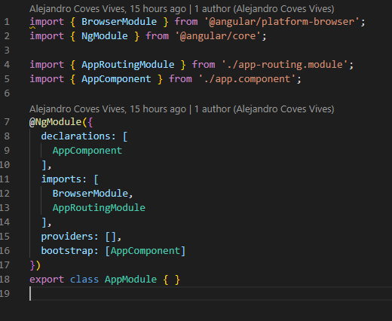
app.module.ts

Slide 17
app.module.ts
declarations
Definen aquellos componentes que se han creado y que tienen permitido su uso en el scope del HTML incluido en este modulo
Cualquier componente tiene que ser declarado antes de poder ser utilizado.
imports
Sirve para traerte y utilizar otros módulos ya creados con sus componentes, servicios, pipes, etc..
providers
Para servicios, pipes, etc… y poder utilizarlos en las vistas y los controladores
bootstrap
Define el componente que sirve de puerta de entrada a nuestra aplicación.

Slide 18
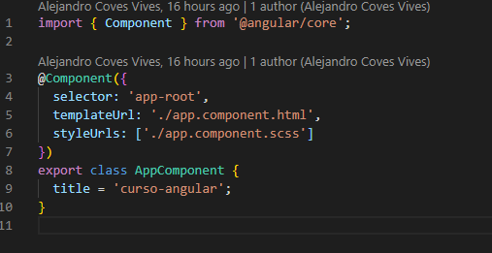
app.component
Do you know what helps you make your point clear? Lists like this:
Because they’re simple
You can organize your ideas clearly
And because you’ll never forget to buy milk!
And the most important thing: the audience won’t miss the point of your presentation
Notes:
A component in Angular is nothing but a TypeScript class, decorated with some
attributes and metadata. The class encapsulates all the data and functionality of the
component, while the decorator specifies how it translates into the HTML.
The app-selector is a CSS selector that identifies how Angular finds this particular
component in any HTML page. While we generally use element selectors ( app-root
in the preceding example, which translates to looking for <app-root> elements in the
HTML), they can be any CSS selector, from a CSS class to an attribute as well.
The templateUrl is the path to the HTML used to render this component. We can
also use inline templates instead of specifying a templateUrl like we have done in the
example. In this particular case, the template we are referring to is app.compo‐
nent.html.
styleUrls is the styling counterpart to the template, encapsulating all the styles for
this component. Angular ensures that the styles are encapsulated, so you don’t have to
worry about your CSS classes from one component affecting another. Unlike tem
plateUrl , styleUrls is an array.

Slide 19
app.component
Elementos del mismo:
selector: Etiqueta para usar el componente en el html
templateUrl: Ruta del html asociado a ese elemento.
styleUrls: Ruta de las hojas de estilos asociadas
Hay más etiquetas para usar dentro del decorador “Component”. Estas se encuentran en https://angular.io/api/core/Component

Slide 20
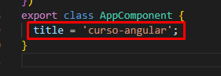
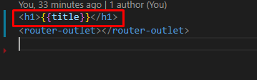
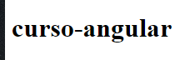
app.component
Notes:
The component class itself finally encapsulates all the functionality backing your
component. It makes it easy to think of the responsibilities of the component class as
twofold:
• Load and hold all the data necessary for rendering the component
• Handle and process any events that may arise from any element in the
Component
The data in the class will drive what can be displayed as part of the component. So
let’s take a look at what the template for this component looks like:
<h1>
{{title}}
</h1>
Data-bound title from the component
Our HTML is as simple as can be for the component. All it has is one element, which
is data-bound to a field in our component class. The double-curly ( {{ }} ) syntax is
an indication to Angular to replace the value between the braces with the value of the
variable from the corresponding class.

Slide 21
03
Creación de modules y componentes
Creación y uso de componentes y de modules

Slide 22
¿POR DONDE EMPEZAR?
Podríamos empezar haciendo un componente en si y mostando como ponerlo en el app.module peeeero vamos a crear un modulo y poner ese componente ahí para exportarlo y ver los casos de uso

Slide 23
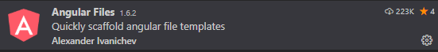
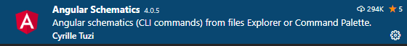
angular cli
Creación de module
Extensiones de visual studio code
ng generate module nombre-modulo

Slide 24

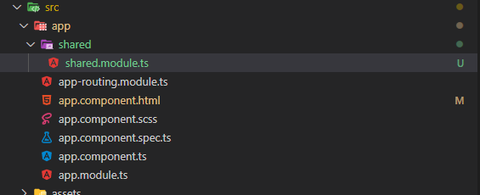
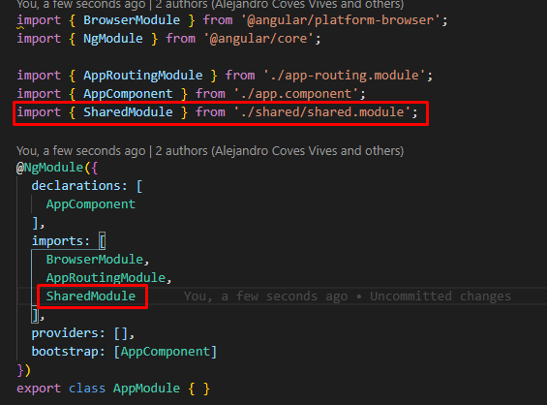
Creamos el module shared y si no está lo ponemos en app.module

Slide 25
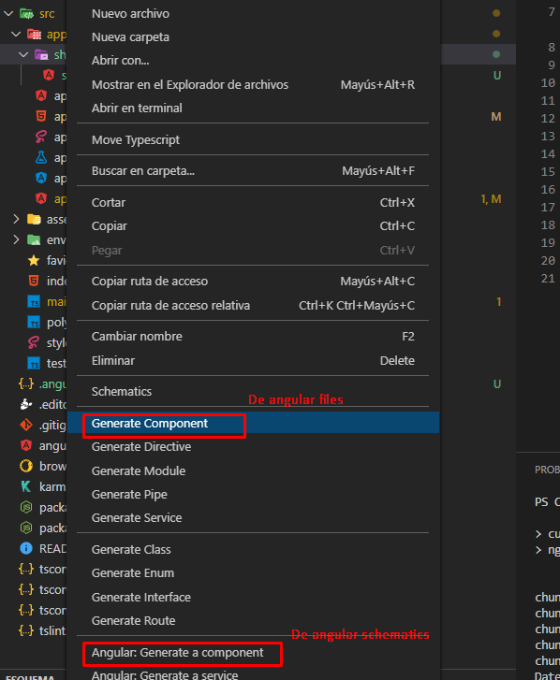
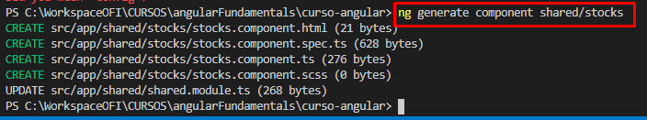
Creamos un componente dentro de shared
Extensiones de Visual Studio Code (click derecho en shared)
Angular cli
Notes:
There are a few interesting things to note here:
• The Angular CLI has a command called generate , which can be used to generate
components (like we did in the preceding example), and also to generate other
Angular elements, such as interfaces, services, modules, and more.
• With the target type, we also specify the name (and the folder) within which the
component has to be generated. Here, we are telling the Angular CLI to generate
a component called stock-item within a folder called stock. If we don’t specify
stock , it will create a component called stock-item in the app folder itself.
The command will generate all the relevant files for a new component, including:
• The component definition (named stock-item.component.ts)
• The corresponding template definition (named stock-item.component.html)
• The styles for the component (in a file named stock-item.component.css)
• The skeleton unit tests for the component (named stock-item.component.spec.ts)
In addition, it updated the original app module that we saw earlier so that our Angu‐
lar application recognizes the new module.
This is the recommended convention to follow whenever you are working with
components:
• The filename starts with the name of the item you are creating
• This is followed by the type of element it is (in this case, a component)
• Finally, we have the relevant extension
This allows us to both group and easily identify relevant and related files in a simple
manner

Slide 26
¿YA ESTÁ?
Vamos a probar a utilizar este componente en nuestro html inicial

Slide 27
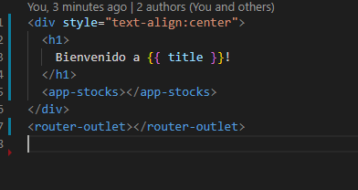
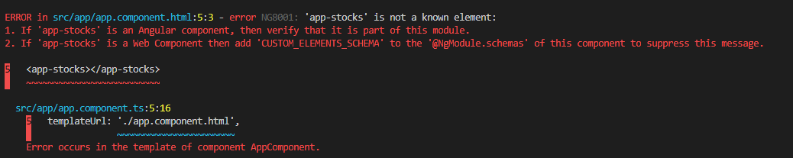
Modificamos el html inicial y damos a npm start
app.component.html
Por consola
Notes:
There are a few interesting things to note here:
• The Angular CLI has a command called generate , which can be used to generate
components (like we did in the preceding example), and also to generate other
Angular elements, such as interfaces, services, modules, and more.
• With the target type, we also specify the name (and the folder) within which the
component has to be generated. Here, we are telling the Angular CLI to generate
a component called stock-item within a folder called stock. If we don’t specify
stock , it will create a component called stock-item in the app folder itself.
The command will generate all the relevant files for a new component, including:
• The component definition (named stock-item.component.ts)
• The corresponding template definition (named stock-item.component.html)
• The styles for the component (in a file named stock-item.component.css)
• The skeleton unit tests for the component (named stock-item.component.spec.ts)
In addition, it updated the original app module that we saw earlier so that our Angu‐
lar application recognizes the new module.
This is the recommended convention to follow whenever you are working with
components:
• The filename starts with the name of the item you are creating
• This is followed by the type of element it is (in this case, a component)
• Finally, we have the relevant extension
This allows us to both group and easily identify relevant and related files in a simple
manner

Slide 28
¿QUÉ ESTA PASANDO?
Aunque tengamos el componente dentro del modulo de shared, necesitamos un paso más si queremos que pueda ser usado dentro de un modulo que no sea el propio que se haya importado

Slide 29
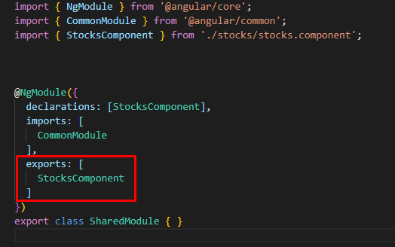
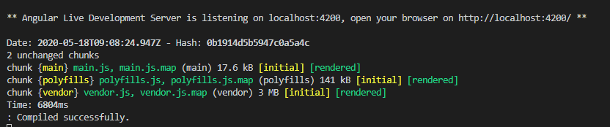
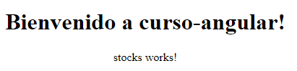
Añadimos la propiedad exports con dicho componente y volvemos a npm start

Slide 30
EJERCICIO!
Antes de seguir vamos a crear otro componente que se llame stock-item y que este dentro de stock.

Slide 31
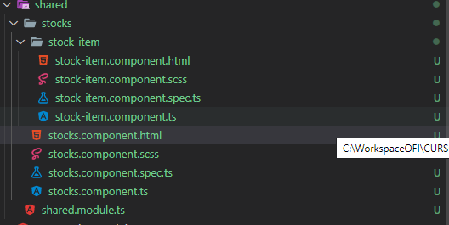
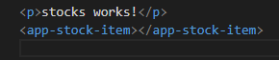
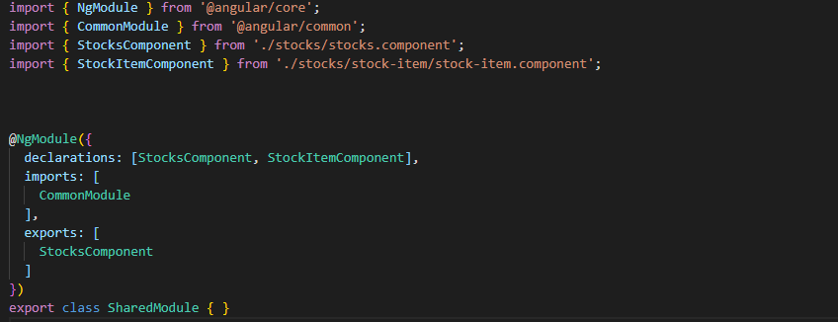
¿Por qué funciona sin export? Funciona porque lo utiliza internamente stocks y es parte del modulo donde se ha declarado y no se utiliza fuera de este modulo

Slide 32
04
Entendiendo conceptos
Data binding, property binding, event binding y modelos

Slide 33
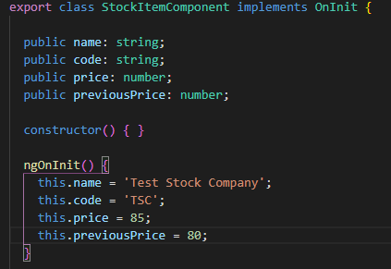
ENTENDIENDO DATA BINDING
Vamos a modificar nuestro StockItemComponent de la siguiente manera:
1
2
3
4

Slide 34
ENTENDIENDO DATA BINDING
Para poder utilizar ngOnInit debemos hacer que la clase implemente su interfaz.
Es muy buena práctica declarar las variables globales del componente justo después de la definición de la clase del mismo. Intentar tipar todo lo posible (para eso utilizamos typescript, nada de any). Aquí dentro ya hay por gustos:
Declaración únicamente y no asignación (mi favorita)
Declaración y asignación de los datos iniciales que se sepa.
El constructor se ejecutará antes de hacer el bindeo de las variables que se le pasen al componente y sirve también para inyección de dependencias (lo daremos más adelante). Básicamente se ejecuta antes que ngOnInit.
ngOnInit: Uno de los muchos estados de ciclo de vida de componente de angular (se verán más adelante). Se ejecuta cuando el componente es inicializado (tiene el contexto de las variables que se le pasan por Input y de los output)

Slide 35
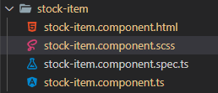
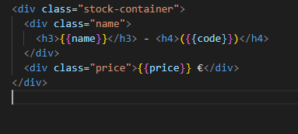
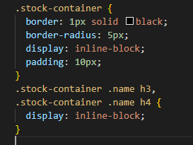
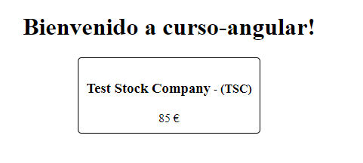
Vamos a implementarlo en nuestro código
Notes:
We have just used one fundamental building block from Angular to render our data
from our component into the HTML. We use the double-curly notation ( {{ }} ),
which is also known as interpolation. Interpolation evaluates the expression between
the curly braces as per the component backing it, and then renders the result as
a string in place in the HTML. In this case, we render the name, code, and the price of
the stock using interpolation. This picks up the values of name, code, and price, and
then replaces the double-curly expression with its value, thus rendering our UI.
This is Angular’s one-way data binding at work. One-way data binding simply refers
to Angular’s capability to automatically update the UI based on values in the compo‐
nent, and then keeping it updated as the value changes in the component. Without
one-way binding, we would have to write code to take the value from our component,
find the right element in HTML, and update its value. Then we would have to write
listeners/watchers to keep track of when the value in the component changes, and
then change the value in the HTML at that time. We can get rid of all of this extra
code because of data binding.
In this particular case, we are binding to simple variables, but it is not necessarily
restricted to simple variables. The expressions can be slightly more complex. For
example, we could render the same UI by changing the binding expression as follows
in stock-item.component.html:
<div class="stock-container">
<div class="name">{{name + ' (' + code + ')'}}</div>
<div class="price">$ {{price}}</div>
</div>
In this case, we replaced our multiple heading elements with a single div. The interpo‐
lation expression is now a combination of both the name and the code, with the code
surrounded by parentheses. Angular will evaluate this like normal JavaScript, and
return the value of it as a string to our UI.

Slide 36
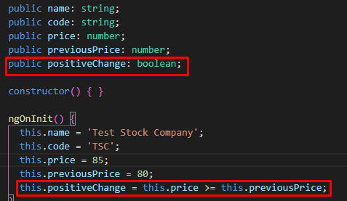
ENTENDIENDO PROPERTY BINDING
Vamos a modificar nuestro StockItemComponent de la siguiente manera:

Slide 37
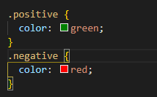
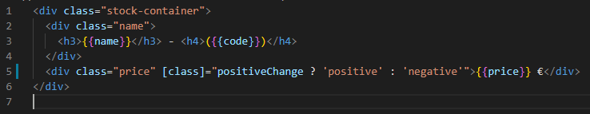
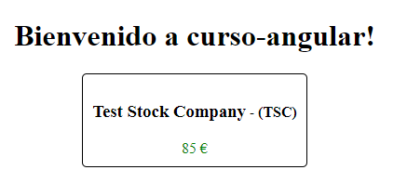
Vamos a implementarlo en nuestro código
Notes:
This is the Angular syntax for property binding, which binds the value of the expres‐
sion to the DOM property between the square brackets. The [] is the general syntax
that can be used with any property on an element to bind one-way from the compo‐
nent to the UI.
In this particular case, we are telling Angular to bind to the class property of the
DOM element to the value of the expression. Angular will evaluate it like a normal
JavaScript expression, and assign the value (positive in this case) to the class property
of the div element.

Slide 38
ENTENDIENDO PROPERTY BINDING
De aquí podemos extraer varios puntos:
Podemos bindear valores de expresiones a propiedades del DOM.
La sintaxis [ ] normalmente se utiliza para bindear de manera “one-way”
En versiones anteriores de angular utilizar [class] en lugar de [ngClass] reemplazaría la existente en el class normal. En este caso tras inspeccionar el elemento sigue la clase “price" (cuidado con esto y con la versión de angular usada, lo suyo es utilizar ngClass (se verá más adelante).
Notes:
This is the Angular syntax for property binding, which binds the value of the expres‐
sion to the DOM property between the square brackets. The [] is the general syntax
that can be used with any property on an element to bind one-way from the compo‐
nent to the UI.
In this particular case, we are telling Angular to bind to the class property of the
DOM element to the value of the expression. Angular will evaluate it like a normal
JavaScript expression, and assign the value (positive in this case) to the class property
of the div element.
When you bind to the class property like we did in the example,
note that it overrides the existing value of the property. In our
example, the "price" class is replaced with the class "positive" ,
instead of appending to the existing value of the property. You can
notice this for yourself if you inspect the rendered HTML in the
browser. Be careful about this if you bind directly to the class
property.
If the value of the variable positiveChange in the component changes, Angular will
automatically re-evaluate the expression in the HTML and update it accordingly. Try
changing the price so that there is a negative change and then refresh the UI to make
sure it works.
Notice that we have been explicitly referring to the data binding working with DOM
properties, and not HTML attributes. The following sidebar goes into more detail on
the difference between the two, and why it is important to know and understand as
you work on Angular. But simplifying it, Angular data binding only works with
DOM properties, and not with HTML attributes.
Just like we did for the class property, depending on the use case, we can actually
bind to other HTML properties like the src property of an img tag, or the disabled
property of input and button . We will cover this in more depth in the next chapter.
We will also cover a simpler and more specific way of binding CSS classes in the next
chapter as well.

Slide 39
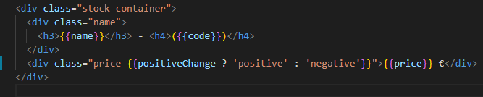
ENTENDIENDO PROPERTY BINDING
Podemos dejar que la variable la gestione angular o el propio DOM:
Es aconsejable dejársela en manos de angular para que tenga control de sus ciclos internos y no haya resultados inesperados con el cambio de valor de dicha variable
Queda más limpio y mantenible si no tenemos que lidiar con {{}} también dentro de las propiedades de elementos del DOM

Slide 40
ENTENDIENDO PROPERTY BINDING
Hay que tener en cuenta:
Estamos trabajando con propiedades de elementos del DOM y no con los elementos en sí cuando les bindeamos a variables.
No podemos hacer variable el propio tag del elemento, para que se visualice uno u otro habrá que hacer uso de herramientas tipo ngIf o ngSwitch.
Notes:
As mentioned, when we work with data binding in Angular, we aren’t working with
HTML attributes but rather DOM properties. Attributes are defined by HTML, while
properties are defined by the Document Object Model. Though some attributes (like
ID and class) directly map to DOM properties, others may exist on one side but not
the other.
But more importantly, the distinction between the two is that HTML attributes are
generally used for initialization of a DOM element, but after that, they have no pur‐
pose or effect on the underlying element. Once the element is initialized, its behavior
is controlled by the DOM properties from then on.
For example, consider the input HTML element. If we bootstrap our HTML with
something like:
<input type="text" value="foo"/>
this initializes an input DOM element, with the initial value of the DOM property
value to be set to foo . Now let’s assume we type something in the text box, say bar . At
this point:
• If we do input.getAttribute('value') , it would return foo , which was the
attribute value we used to initialize the HTML.
• If we do input.value , we will get the current value of the DOM property, which
is bar .
That is, the attribute value is used to boostrap and set the initial value of the HTML
DOM element, but after that, it is the DOM property that drives the behavior. If you
inspect the HTML, you will see that it is still the initial HTML we provided, and does
not update either.
In Angular, we thus bind to the DOM property, and not to the HTML attributes.
Whenever we think about one-way binding from the component to the UI, we should
always keep this in mind!

Slide 41
ENTENDIENDO EVENT BINDING
Vamos a modificar otra vez el componente para añadir un evento al pulsar un botón

Slide 42
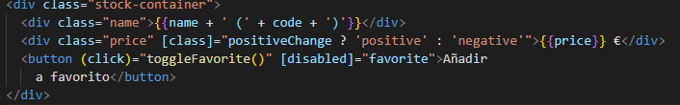
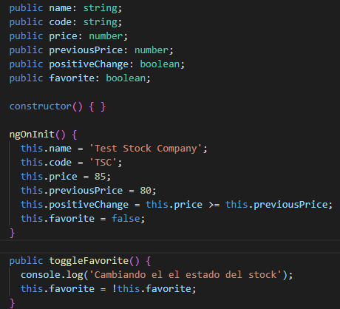
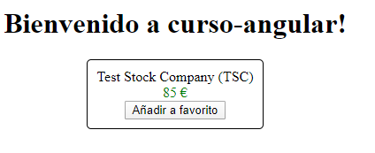
Vamos a implementarlo en nuestro código
Notes:
So far, we have worked on using the data in our component to both render values and
change the look and feel of our component. In this section, we will start understand‐
ing how to handle user interactions, and work with events and event binding in
Angular.
Say we wanted to have a button that allows users to add the stock to their list of favor‐
ite stocks. Generally, with a button like this, when the user clicks it, we would want to
make some server call and then process the result. So far, since we are working with
very simple examples, let’s just say we wanted to handle this click and get a hook to it
in our component. Let’s see how we might accomplish that.
We have added a new public boolean member variable called favorite , which is ini‐
tialized with a false value. We then added a new function called toggleFavorite() ,
which simply flips the boolean value of favorite . We are also printing a log in the
console to ensure this is getting triggered.
We have added a new button in the stock-item.component.html file to allow users to
click and add the stock to their favorite set. We are using the data-binding concept
from the previous section on the disabled property. Thus, we are disabling the but‐
ton based on the boolean value favorite . If favorite is true , the button will be dis‐
abled, and if it is false , the button will be enabled. Thus, by default, the button is
enabled.
The other major thing we have on the element is this fragment:
(click)="toggleFavorite()"
This syntax is called event binding in Angular. The left part of the equals symbol refers
to the event we are binding to. In this case, it is the click event. Just like how the
square-bracket notation refers to data flowing from the component to the UI, the
parentheses notation refers to events. And the name between the parentheses is the
name of the event we care about
In this case, we are telling Angular that we are interested in the click event on this
element. The right part of the equals symbol then refers to the template statement
that Angular should execute whenever the event is triggered. In this case, we want it
to execute the new function we created, toggleFavorite
Notice the other interesting thing, which is Angular data binding at play. When we
click the button, our toggleFavorite function is executed. This flips the value of
favorite from false to true . This in turn triggers the other Angular binding, which
is the disabled property of the button, thus disabling the button after the first click.
We don’t have to do anything extra to get these benefits, which is the beauty of data
binding.
There are times when we might also care about the actual event triggered. In those
cases, Angular gives you access to the underlying DOM event by giving access to a
special variable $event . You can access it or even pass it to your function as follows

Slide 43
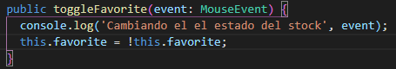
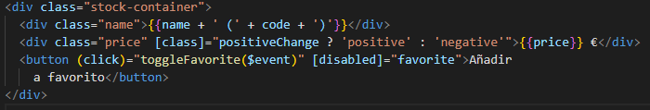
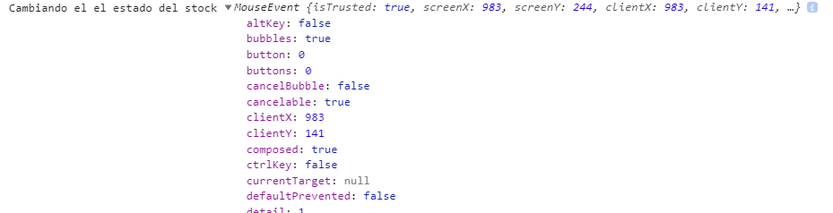
Otra opción
Notes:
So far, we have worked on using the data in our component to both render values and
change the look and feel of our component. In this section, we will start understand‐
ing how to handle user interactions, and work with events and event binding in
Angular.
Say we wanted to have a button that allows users to add the stock to their list of favor‐
ite stocks. Generally, with a button like this, when the user clicks it, we would want to
make some server call and then process the result. So far, since we are working with
very simple examples, let’s just say we wanted to handle this click and get a hook to it
in our component. Let’s see how we might accomplish that.
We have added a new public boolean member variable called favorite , which is ini‐
tialized with a false value. We then added a new function called toggleFavorite() ,
which simply flips the boolean value of favorite . We are also printing a log in the
console to ensure this is getting triggered.
We have added a new button in the stock-item.component.html file to allow users to
click and add the stock to their favorite set. We are using the data-binding concept
from the previous section on the disabled property. Thus, we are disabling the but‐
ton based on the boolean value favorite . If favorite is true , the button will be dis‐
abled, and if it is false , the button will be enabled. Thus, by default, the button is
enabled.
The other major thing we have on the element is this fragment:
(click)="toggleFavorite()"
This syntax is called event binding in Angular. The left part of the equals symbol refers
to the event we are binding to. In this case, it is the click event. Just like how the
square-bracket notation refers to data flowing from the component to the UI, the
parentheses notation refers to events. And the name between the parentheses is the
name of the event we care about
In this case, we are telling Angular that we are interested in the click event on this
element. The right part of the equals symbol then refers to the template statement
that Angular should execute whenever the event is triggered. In this case, we want it
to execute the new function we created, toggleFavorite
Notice the other interesting thing, which is Angular data binding at play. When we
click the button, our toggleFavorite function is executed. This flips the value of
favorite from false to true . This in turn triggers the other Angular binding, which
is the disabled property of the button, thus disabling the button after the first click.
We don’t have to do anything extra to get these benefits, which is the beauty of data
binding.
There are times when we might also care about the actual event triggered. In those
cases, Angular gives you access to the underlying DOM event by giving access to a
special variable $event . You can access it or even pass it to your function as follows

Slide 44
ENTENDIENDO EVENT BINDING
De esto podemos sacar claro varios cosas:
Podremos bindear eventos a funciones públicas.
Los eventos el valor que devuelven los eventos en el html se suele representar como $event . Ej: toggleFavorite($event)
Si una función recibe un parámetro es conveniente tiparla y no dejarla como any (indagar si es de un elemento HTML el tipo que podría ser)
Los cambios en caliente de los eventos si estan bindeados a variables públicas utilizadas en la vista se actualizan automaticamente.

Slide 45
USO DE MODELS
Al estar en un entorno con posibilidad de tipado es conveniente utilizarlo ya que nos aporta:
Limpieza
Encapsulación
Texto predictivo en el IDE (adiós a ver que contiene la variable investigando)
Es conveniente también tener una carpeta models para tenerlos ahí. Dependiendo la envergadura del proyecto podría ser también una carpeta models por modulo o como se quiera organizar, pero es muy conveniente.

Slide 46
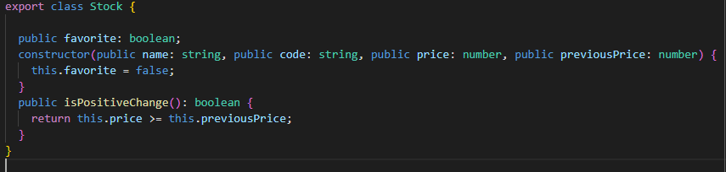
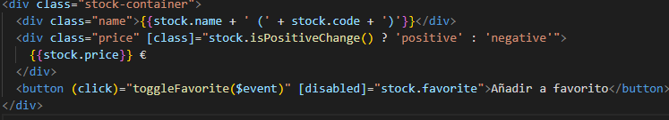
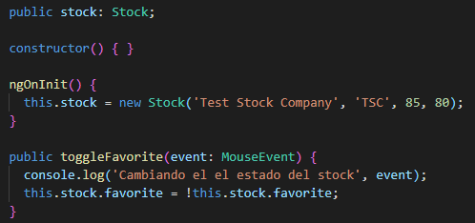
Vamos a implementarlo en nuestro código
Notes:
The last part of this chapter covers something that is more of a best practice, but it is
worth adopting—especially as we aim to build large, maintainable web applications
using Angular. We want to use encapsulation to ensure that our components don’t
work with lower-level abstractions and properties, like we did previously where the
stock widget gets an individual name, price, etc. At the same time, we want to lever‐
age TypeScript to make it easier to understand and reason about our application and
its behavior. To this extent, we should ideally model our stock itself as a type in Type‐
Script, and leverage that instead
The way we would do it in TypeScript is to define an interface or a class with the defi‐
nition for what belongs in a stock, and use that consistently throughout our applica‐
tion. In this case, since we might want additional logic in addition to just the values
(calculating whether the price differential is positive or not, for example), we can use
a class.
We can use the Angular CLI to quickly generate a skeleton class for us, by running:
ng generate class model/stock
This gives us a nice encapsulation while we work with stocks across our application.
Note that we didn’t actually define the variables name , code , and so on as properties of
the class. This is because we are using TypeScript’s syntactic sugar to automatically
create the corresponding properties based on the constructor arguments by using the
public keyword. To learn more about TypeScript classes, refer to the official docu‐
mentation. In short, we have created a class with five properties, four coming through
the constructor and one autoinitialized.
In stock-item.component.ts, we imported our new model definition at the top, and
then replaced all the individual member variables with one variable of type Stock .
This simplified the code in the component significantly, and encapsulated all the logic
and underlying functionality within a proper TypeScript type
We have made a few changes in the HTML for our stock item. First, most of our ref‐
erences to the variable are now through the stock variable, instead of directly access‐
ing the variables in the component. So name became stock.name , code became
stock.code , and so on.
Also, one more thing of note: our class property binding now refers to a function
instead of a variable. This is acceptable, as a function is also a valid expression. Angu‐
lar will just evaluate the function and use its return value to determine the final
expression value.

Slide 47
EJERCICIO PARA TERMINAR PARTE 1

Slide 48
EJERCICIO PARA TERMINAR PARTE 1
Con todo lo visto hasta ahora:
Crea un nuevo componente dentro de shared (no hace falta que esté dentro de stocks)
Visualiza dicho componente en la pantalla (este será un producto, llamalo como quieras)
El componente tiene que mostrar un nombre, precio e imagen para dicho producto. Puedes usar las variables por defecto que quieras.
Crea un nuevo modelo para este producto.
Marca el componente entero de un color si este está disponible (puede ser una nueva propiedad del producto)
Añade botones para sumar o restar la cantidad de producto que quieras.
Añade un marcador con la cantidad total que asciende la suma de la cantidad de productos seleccionados y el número de los mismos.
Pon una cantidad máxima de productos por defecto, controla que si la cantidad de seleccionados sea 0 el botón de menos este deshabilitado

Slide 49


AHORA A POR LA PARTE 2
Vamos a hacer un descansito

